Slide 1


Tutorial 4 - Transmission networks and Electricity Market
Presented by
Raihan Bin Mofidul
PhD Student | Faculty of Engineering and Information Technology
Student ID: 25187713
Supervisor: Prof. Dr. Jahangir Hossain
Co-Supervisor: A/Prof. Li Li

Slide 2
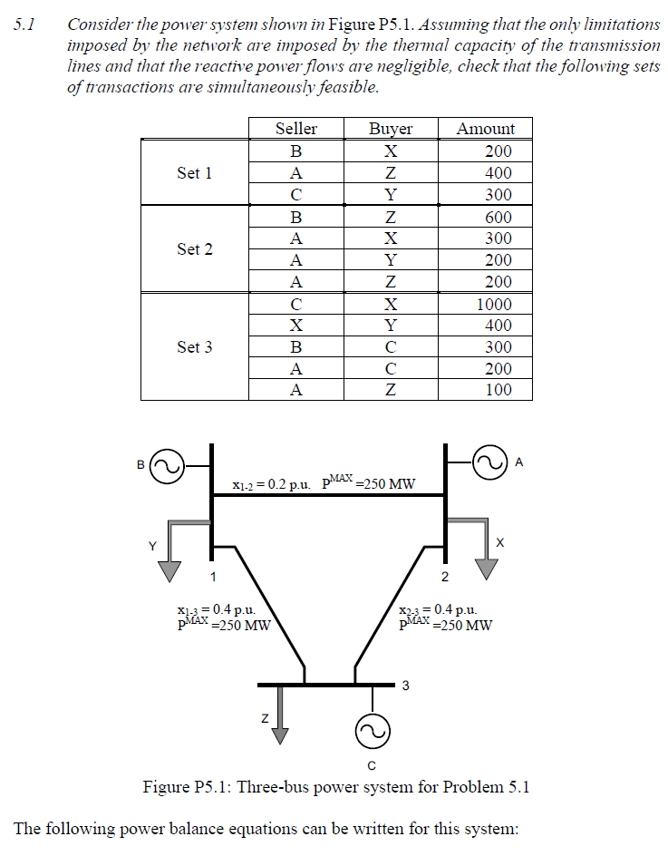
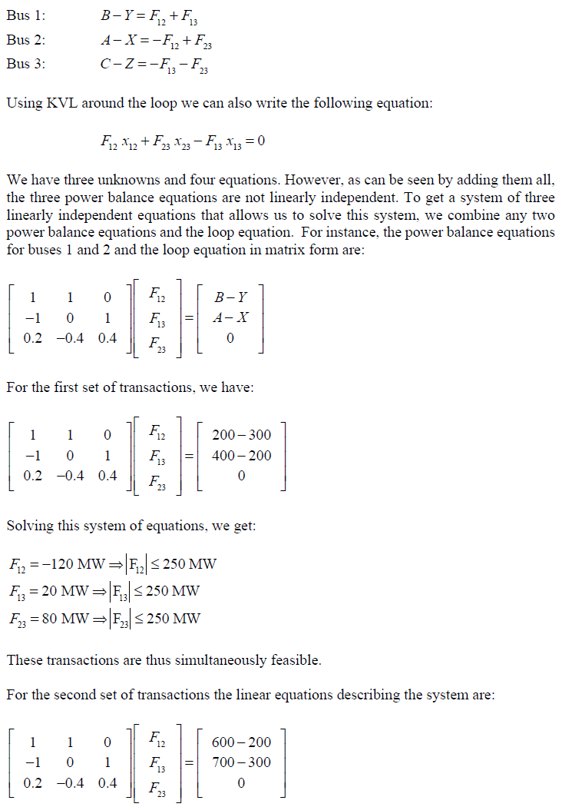
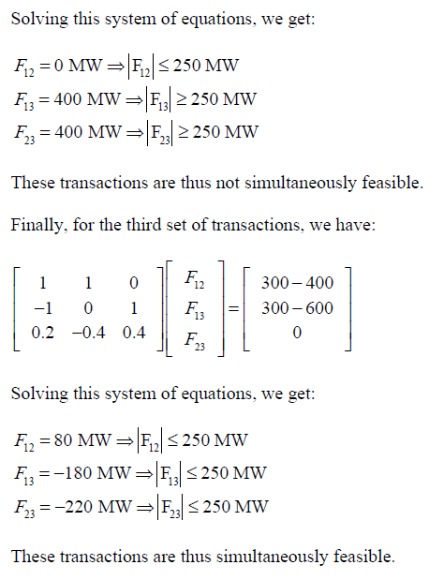
Problem 5.1:

Slide 3
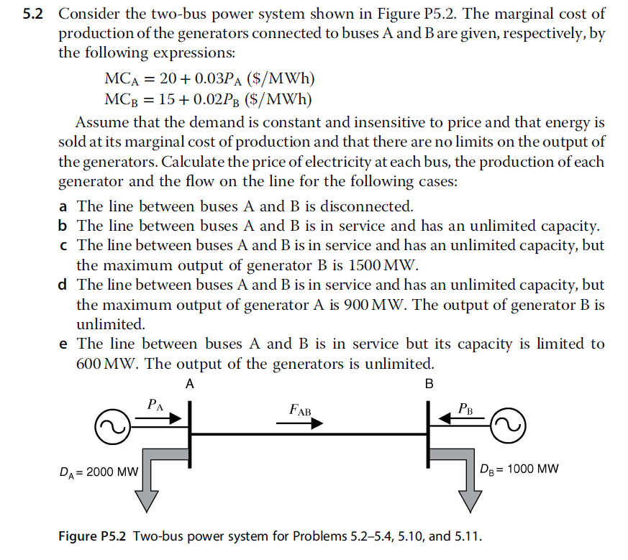
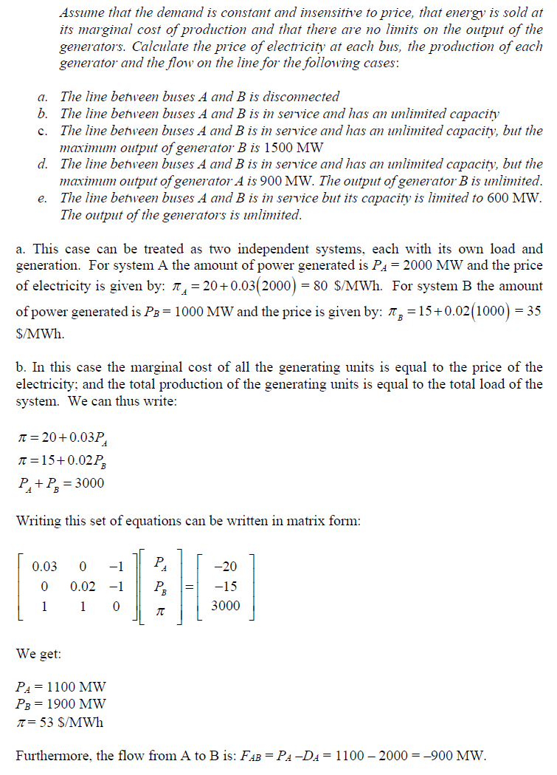
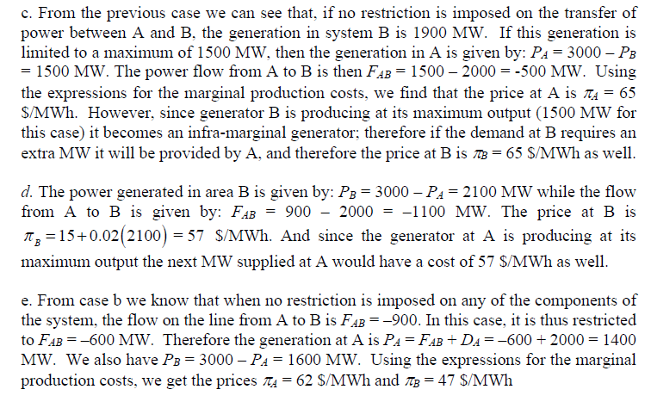
Problem 5.2:

Slide 4
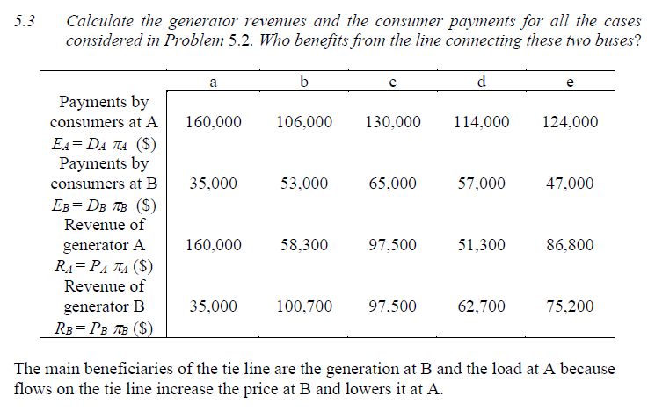
Problem 5.3:

Slide 5
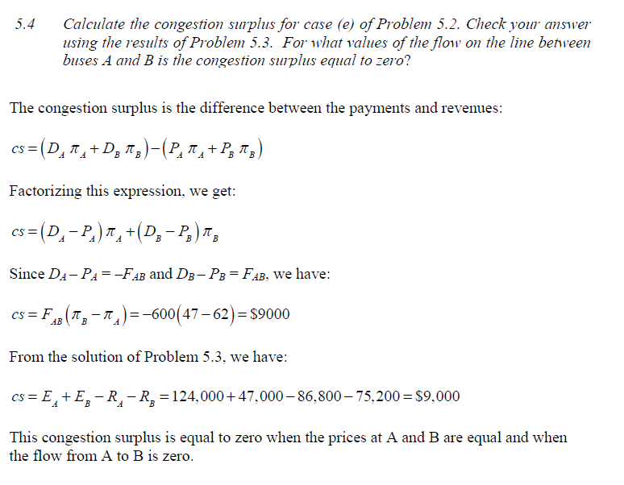
Problem 5.4:

